Slide 1
SPC Final Recognition: Ignoring IFR
Parsed by NaN Count
No NaN: 0 NaNs Per Session
Mid-Low NaN: 16 NaNs Per Session
Mid-High NaN: 56 NaNs Per Session
High NaN: 96 NaNs Per Session

Slide 2
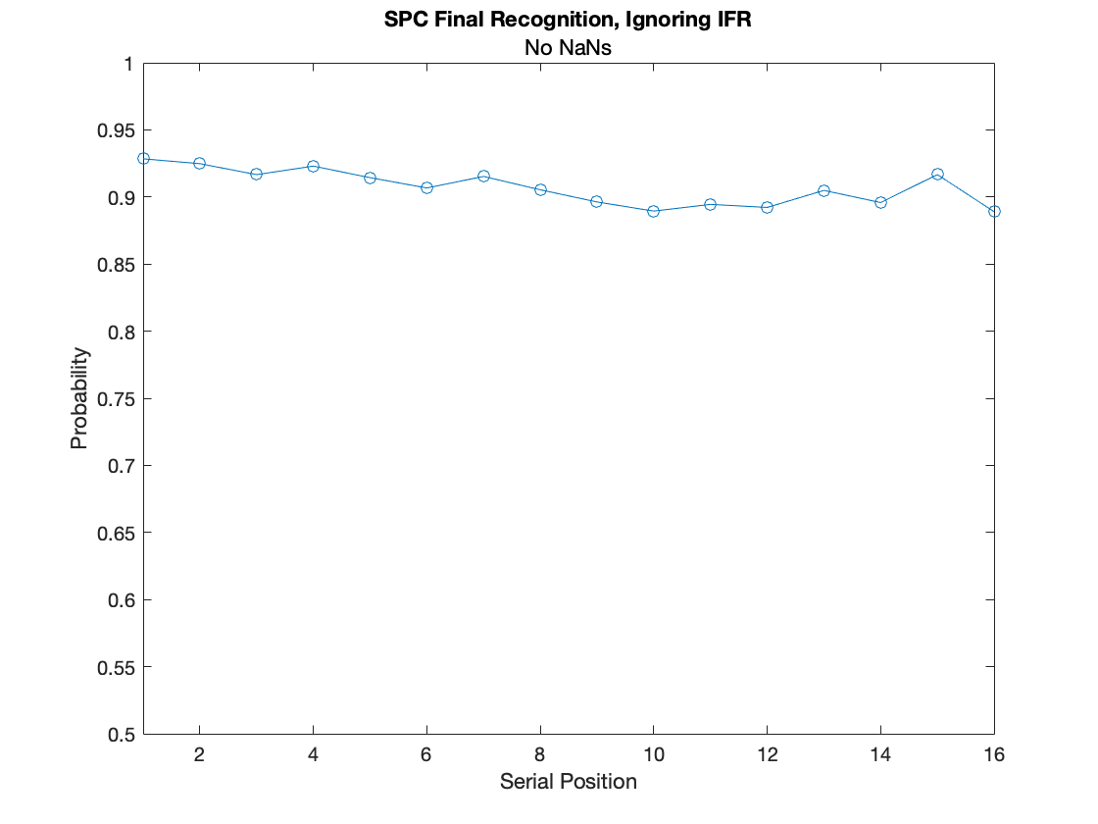
SPC Ignoring IFR: No NaNs

Slide 3
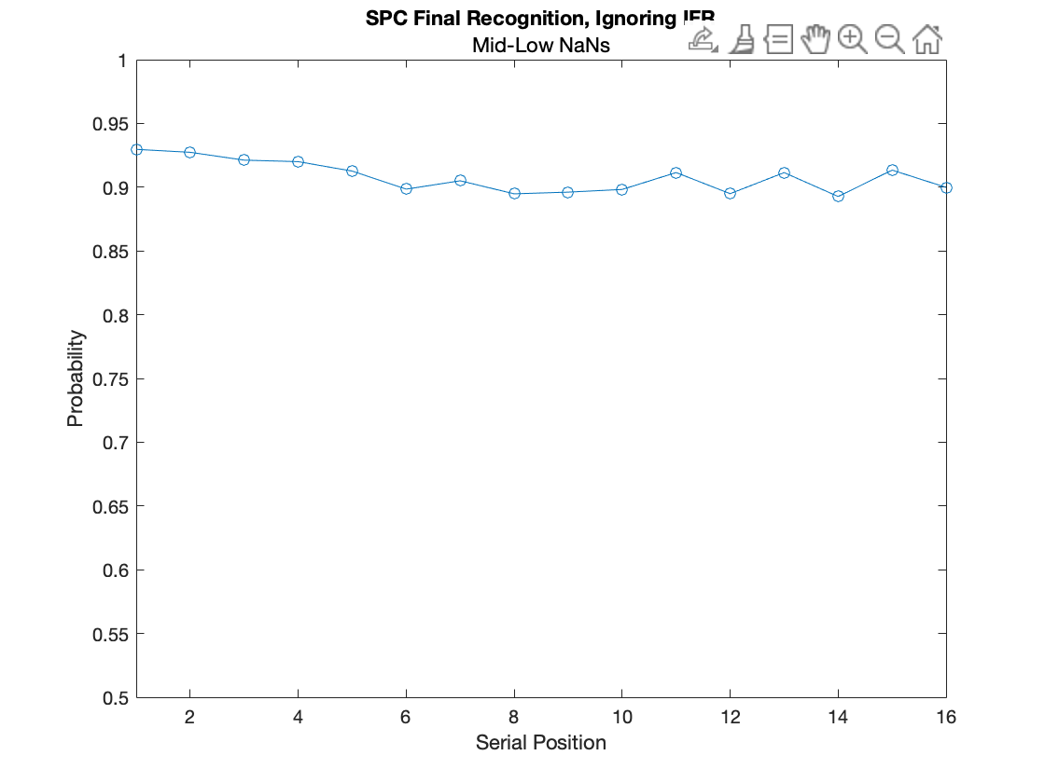
SPC Ignoring IFR: Mid-Low NaNs

Slide 4
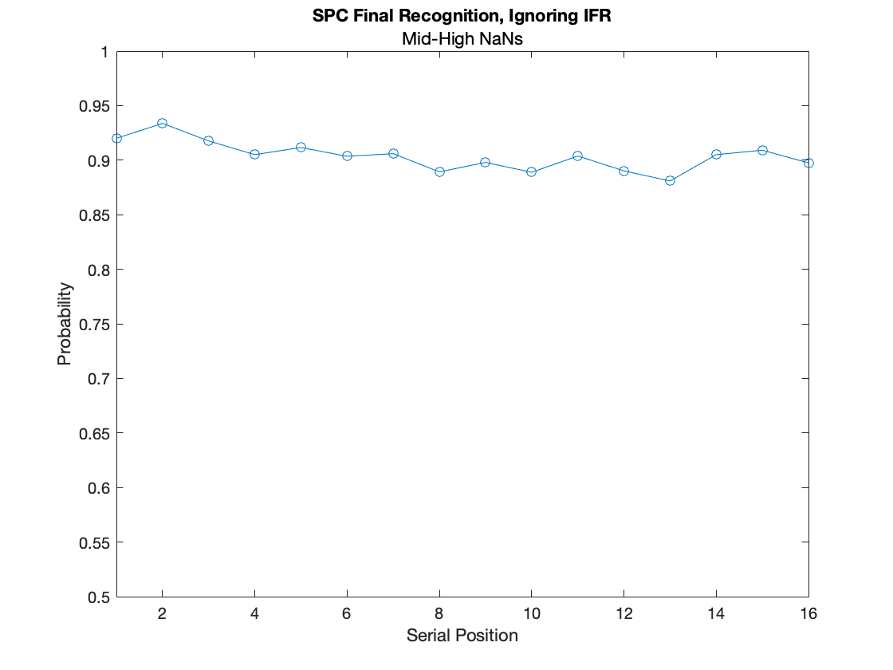
SPC Ignoring IFR: Mid-High NaNs

Slide 5
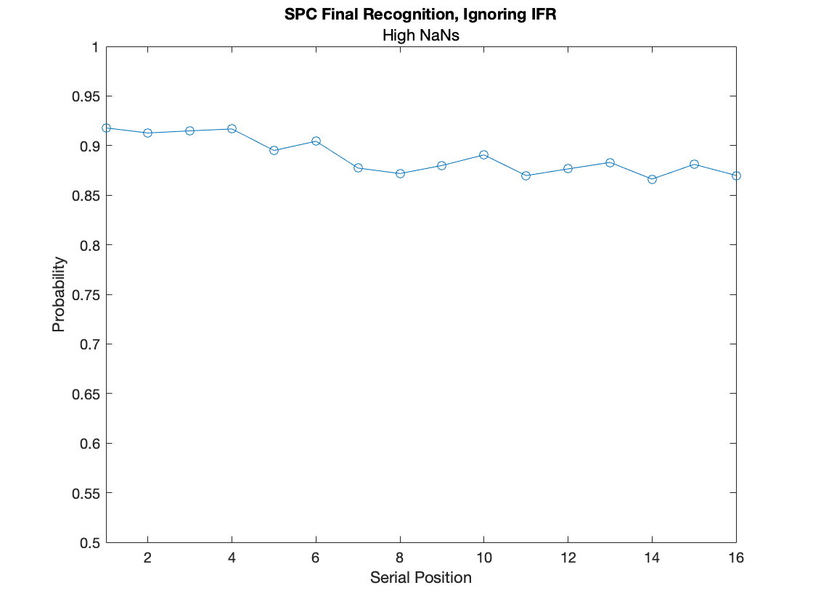
SPC Ignoring IFR: High NaNs

Slide 6
SPC Final Recognition: Conditional on IFR
Parsed by NaN Count
No NaN: 0 NaNs Per Session
Mid-Low NaN: 16 NaNs Per Session
Mid-High NaN: 56 NaNs Per Session
High NaN: 96 NaNs Per Session

Slide 7
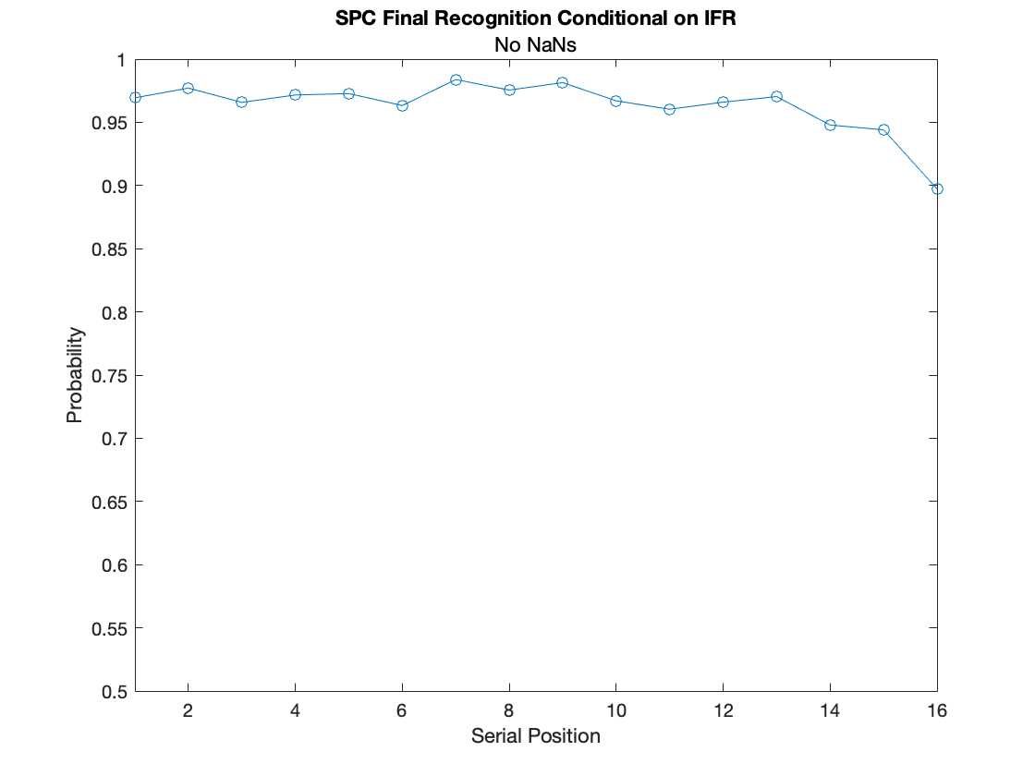
SPC Conditional on IFR : No NaNs

Slide 8
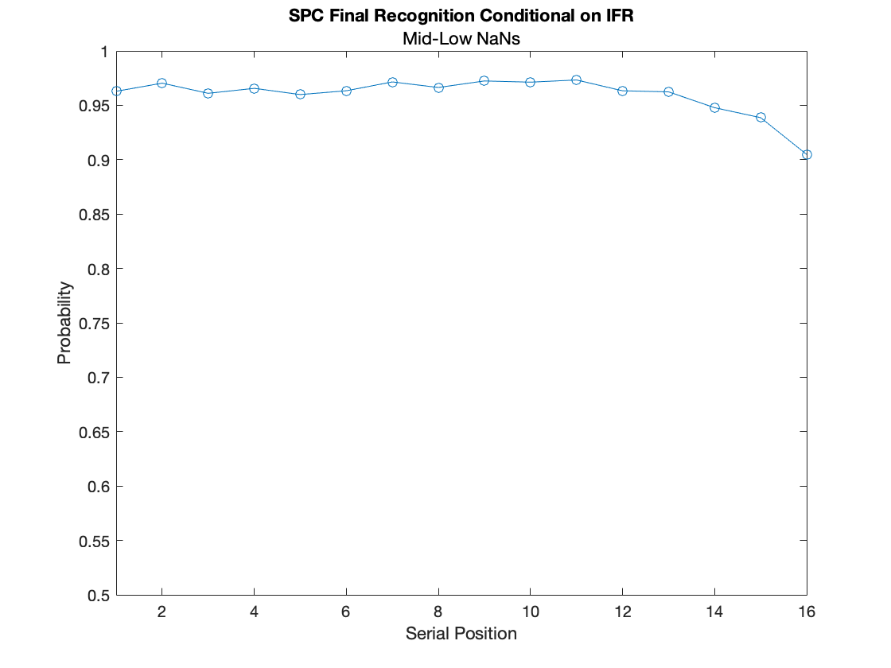
SPC Conditional on IFR : Mid-Low NaNs

Slide 9
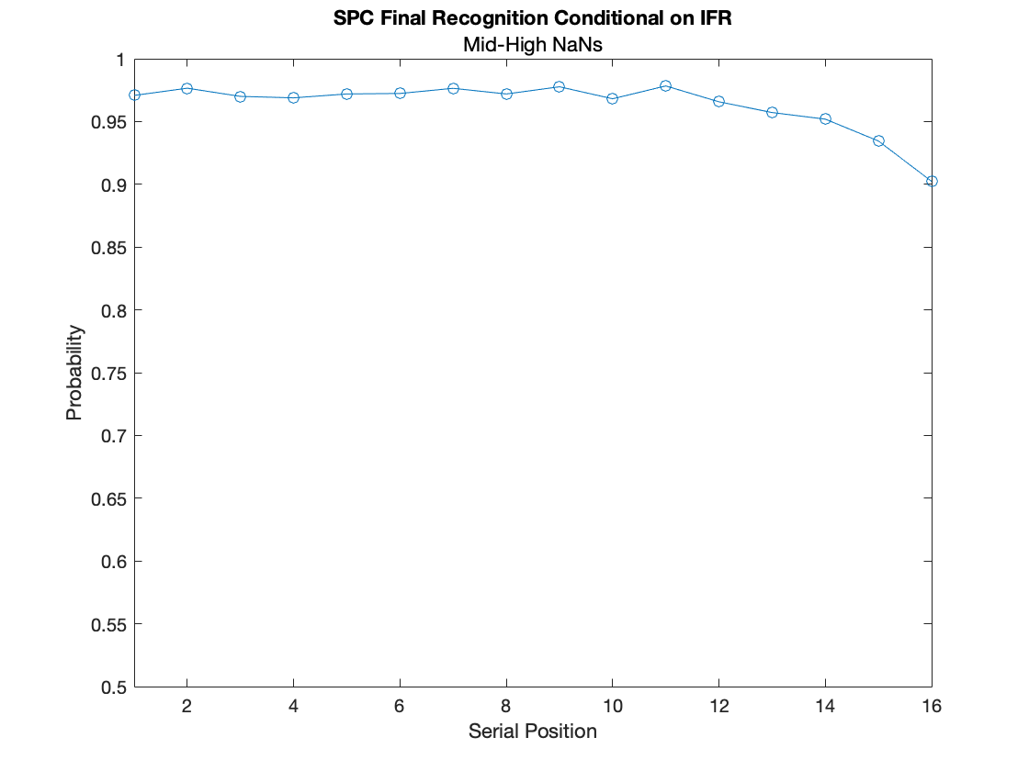
SPC Conditional on IFR : Mid-High NaNs

Slide 10
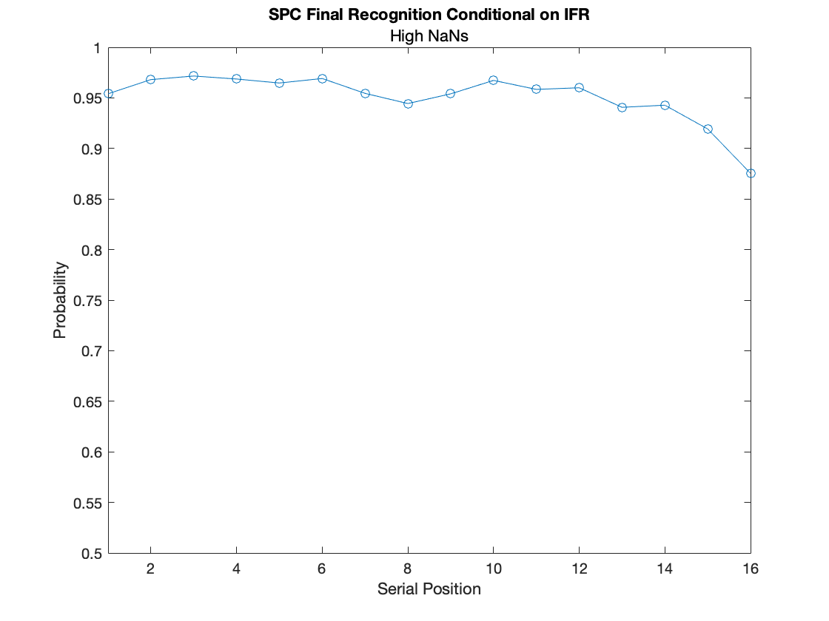
SPC Conditional on IFR : High NaNs

Slide 11
SPC Final Recognition: Excluding IFR Items
After running these plots and noticing that they looked different from my previous “SPC FR: Excluding IFR Items” plots, I noticed that there was a small typo in my previous script.
I was masking out items that were not recalled as NaNs accidentally, resulting in very high proportions between the SP numerator and SP denominator. Although the final calculation for both analyses was the same (i.e. sp_num(i)= sum(~isnan(ifr_fr(:,1)= = 1)) and sp_denom(i)= sum(~isnan(recognized(:,i)))), this was excluding valid opportunities that Ss had to recognize an item that was not recalled.
I’ve included a corrected version of my previous plot with the adjusted code (which matches) and checked different subject/session combinations from both scripts against each other, to make sure that the numbers match as well.

Slide 12
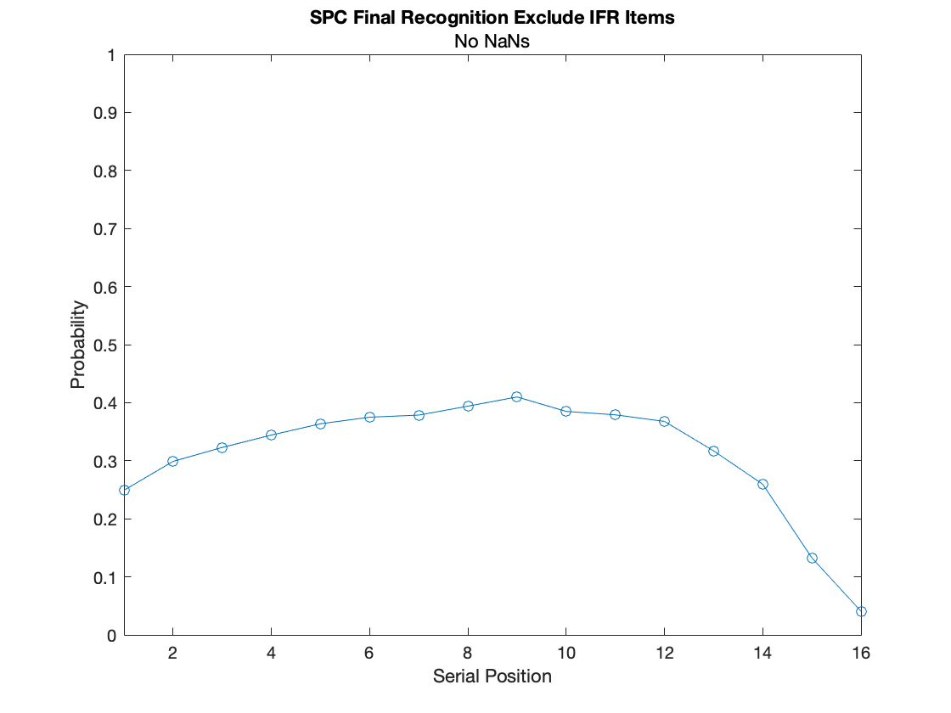
SPC Exclude IFR: High NaNs

Slide 13
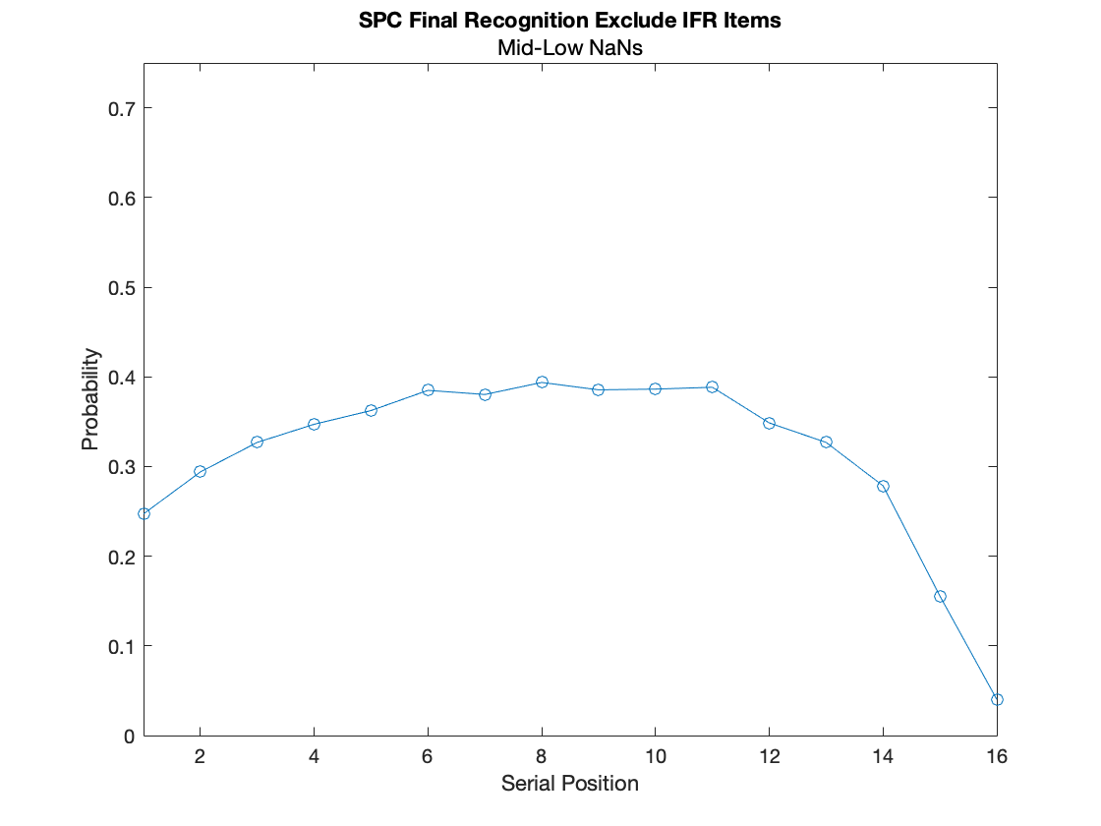
SPC Exclude IFR: High NaNs

Slide 14
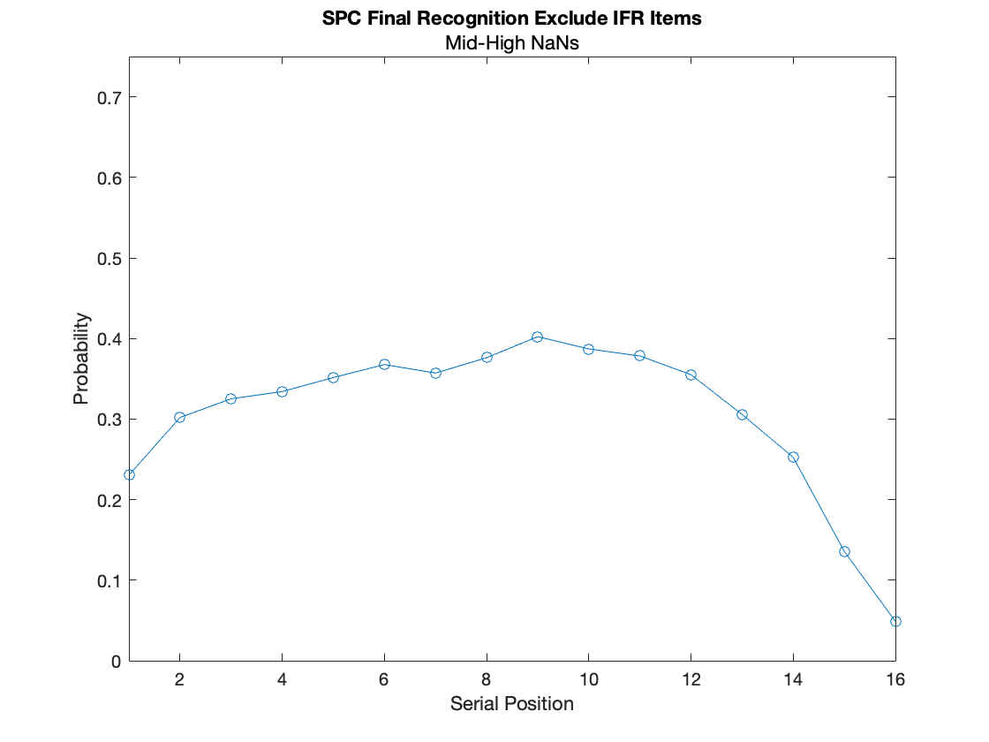
SPC Exclude IFR: High NaNs

Slide 15
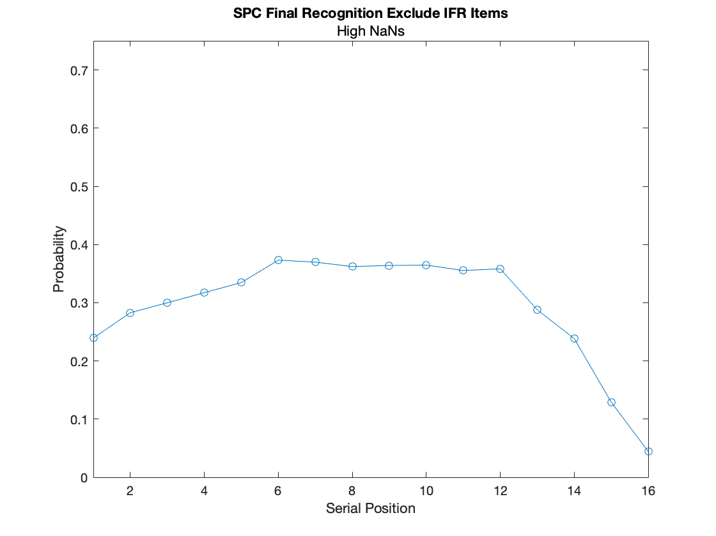
SPC Exclude IFR: High NaNs

Slide 16
SPC Exclude IFR: Not Grouped by NaN Count

Slide 17
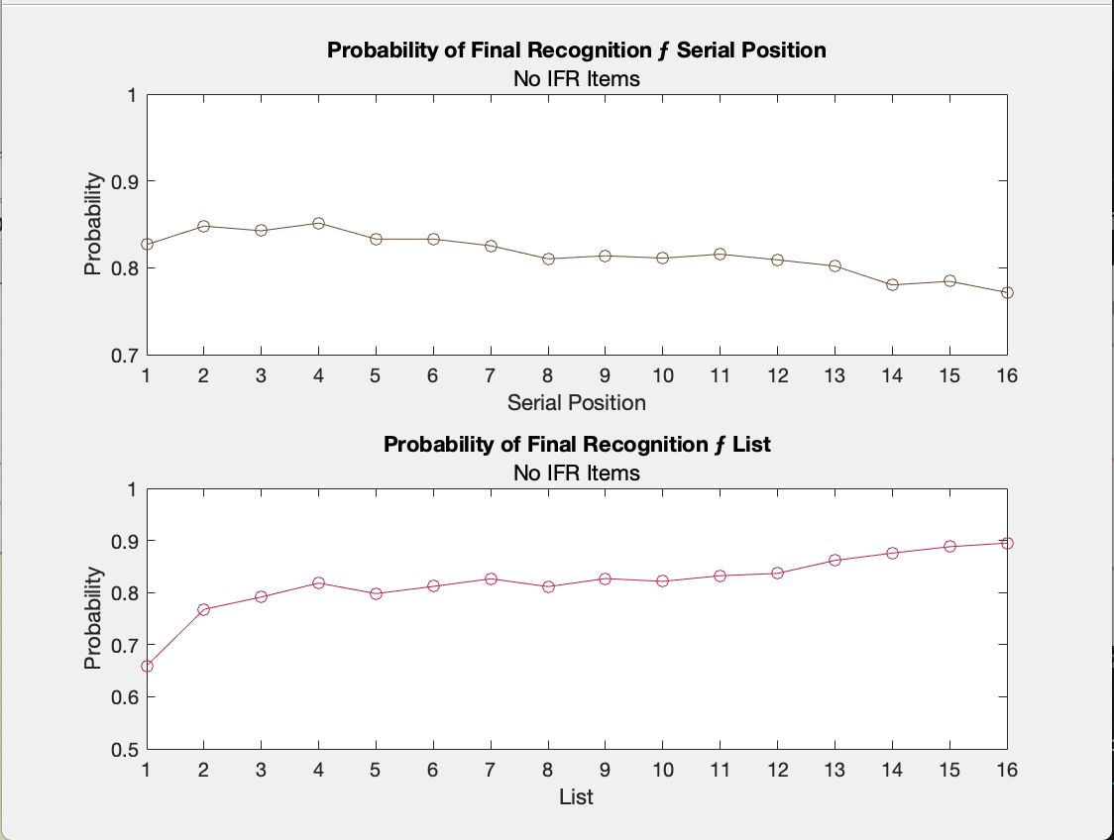
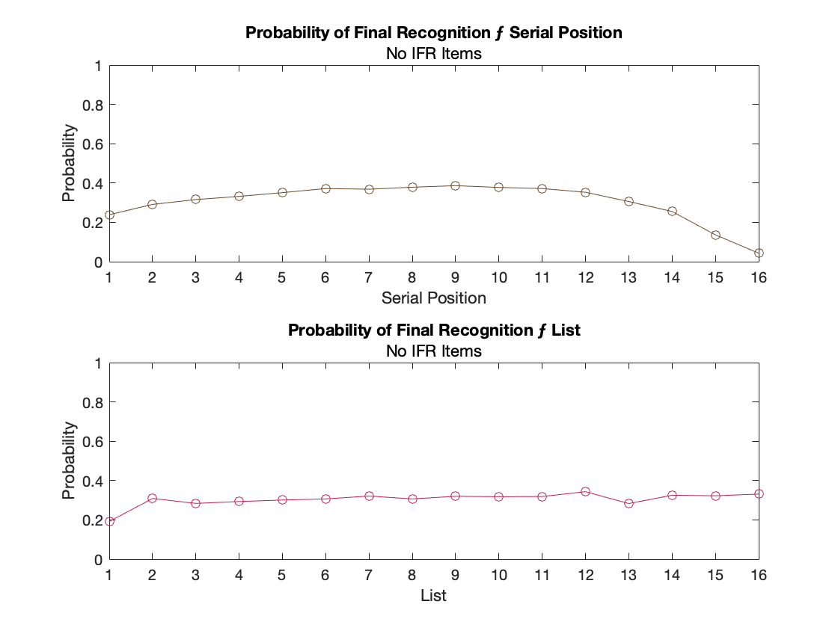
Corrected Version of Previous SPC FR: Exclude IFR Plot

Slide 18
SPC Conditional on IFR : High NaNs

